Slide 1

Two-Layered Recommendation:
An Ingredient-Based Personalization System
July, 2023
Notes:
Entered text
• Risk of Assumption Bias
o Validate assumptions with actual customer data
o Differentiate between personal preferences and broader customer needs
• Risk of Homogeneity Bias
o Actively seeking diverse perspective
o Encourage the team to think from the perspective of various customer segments
• Risk of System Escalation
o Robust capacity planning to accommodate current and future demands
o Implementation of scalable architecture and infrastructure
o Regular feedback collection and analysis from customers
o Continuous validation of assumptions with actual customer data

Slide 2









Haibo Yu
Product Manager
Zikun Shangguan
Data Scientist
Jill Tan
Business Expert
Runze Wang
MLE
Eric Xue
MLE
Di Zhang
Technical Writer
Yanzi Wu
Product Designer
Jenny Wong
Data Scientist

Slide 3


Mission
Continuously enhance customer ordering experience by delivering smooth, relevant and personalized recommendations.
Vision
Lead digital transformation in dessert industry by offering most relevant and personalized ordering experience utilizing innovative data science solutions.

Slide 4
AGENDA
Business Case (1 min)
UX Design Demo (5 min)
Data Enablement (2 min)
Technical Design Demo (1 min)
User Feedback Insights (2 min)
Future Iterations (1 min)
Q & A (8 min)

Slide 5
Business Case

Slide 6





Delightful Customer Experience
On-Brand Competitiveness
Overwhelming and Confusing
Increased Revenue and Profitability

Slide 7
UX Design Demo

Slide 8
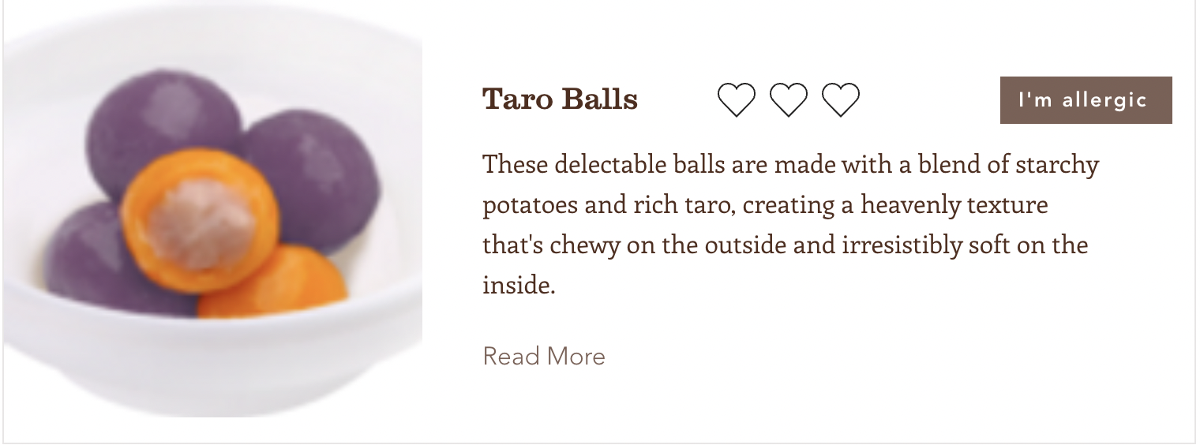
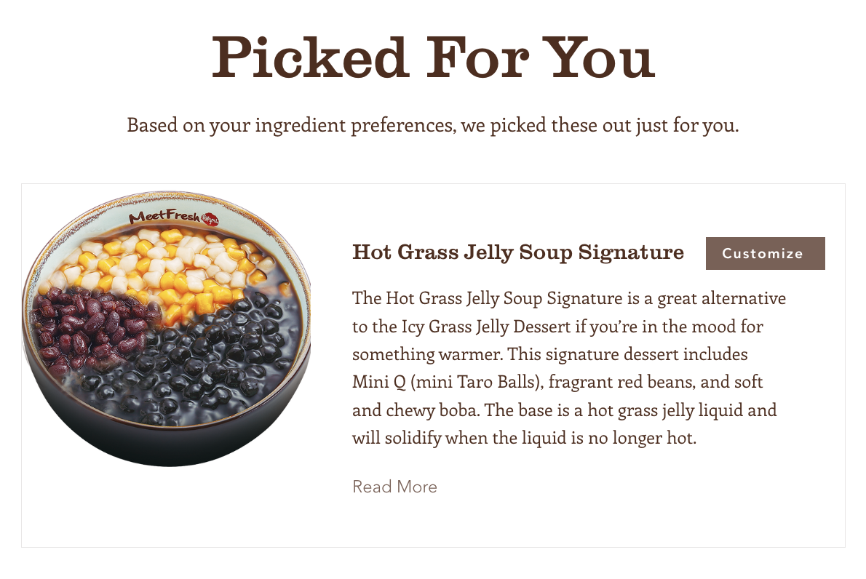

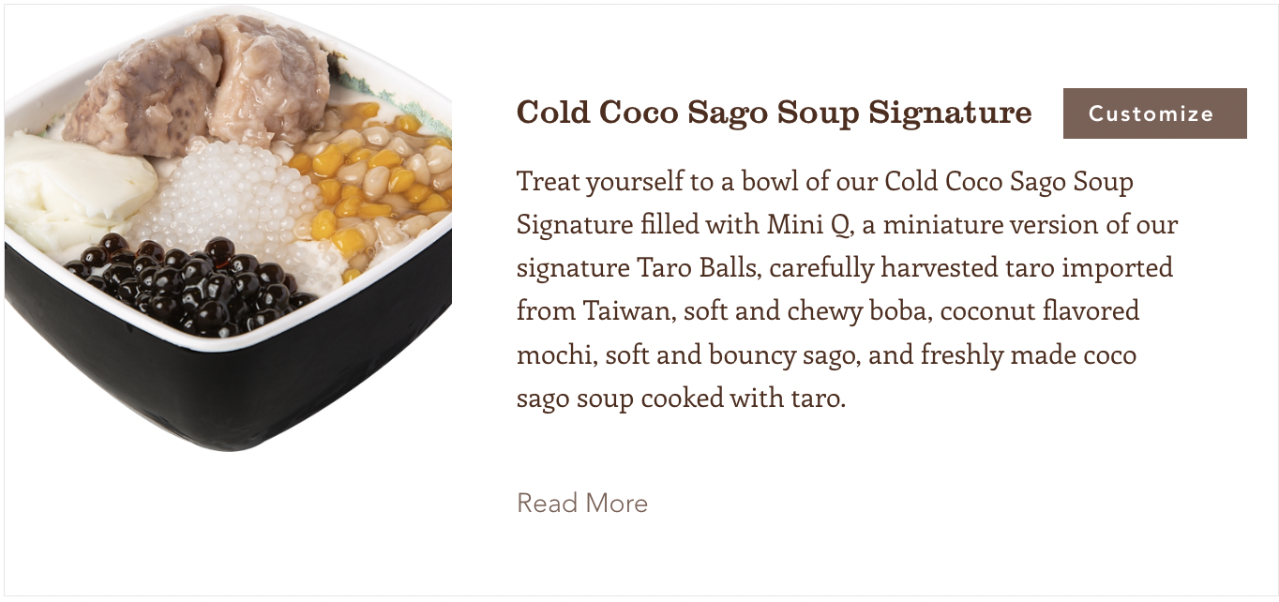
The Meet Fresh Experience
https://haiboyu2628.wixsite.com/meet-fresh

Slide 9
Data Enablement

Slide 10




Store Sales Data
Ingredient, Product Attribute Data
Customer Ratings Data
Meet Fresh Business Partner
Meet Fresh USA Site Catalog
Customized Mock Data

Slide 11
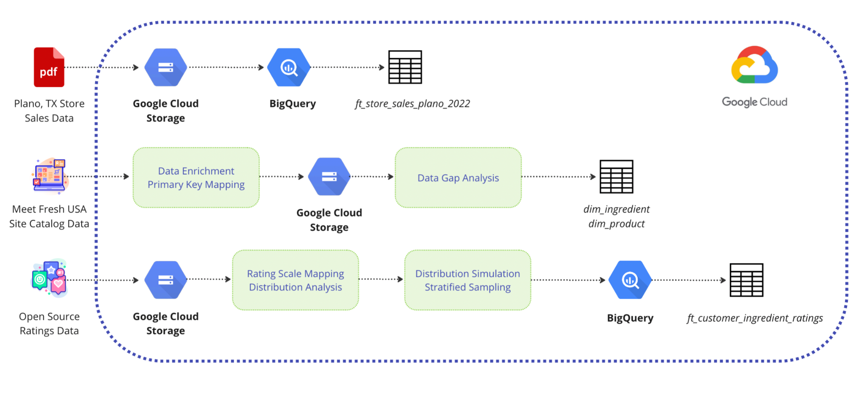

Slide 12
Store Sales Data
ft_store_sales_plano_2022
Business case analysis and forecasting
Aggregated ingredient sales quantity for ratings data simulation
Product Attribute Data
dim_ingredient
dim_product
Product and ingredient features for content-based recommendation algorithms
Customer Ratings Data
ft_customer_ingredient_ratings
Recommendation algorithms’ main input

Slide 13
Technical Design Demo

Slide 14
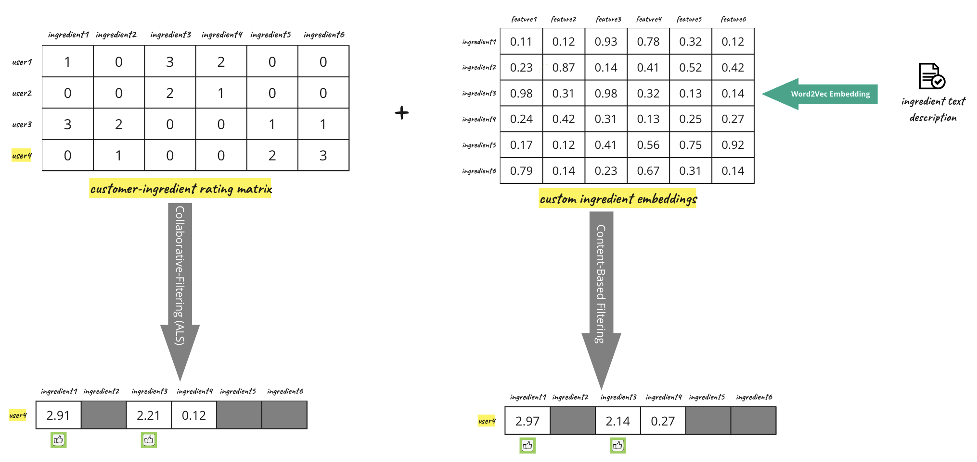
Layer 1: Ingredient-Level
Introduce ingredients that customers might be interested

Slide 15
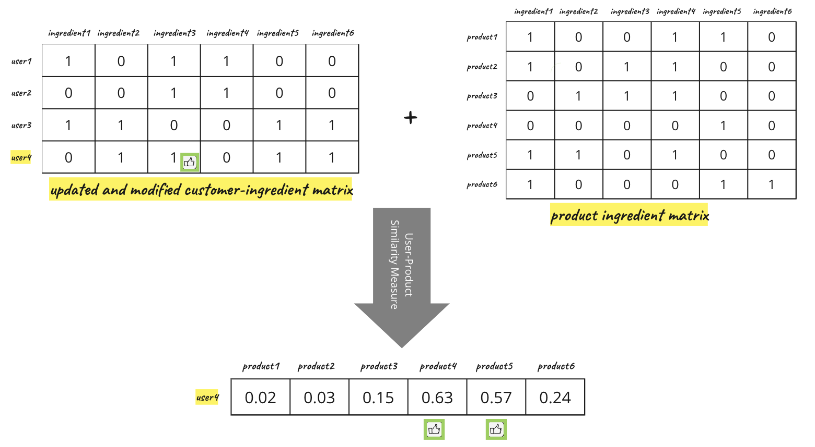
Layer 2: Product-Level
Provide product-level recommendations based on ingredients preferences

Slide 16
User Feedback Insights

Slide 17
Great experience! Convenient and usable.
I love the rating experience in Discover Ingredients!
Effectively guide me to find what I would enjoy.
Would be good to include instructions for providing ratings.
Provide more detailed images overall.

Slide 18
Future Iterations

Slide 19


UI Components
To add a “Need Assistance” button on the upper left corner.
To put more introductions about Meet Fresh, or promos in Our Shops page.
To add Ads and Quotes from Social Media to the Signature Series page.
To enlarge the picture size in the Recommendations for You page.
To refine the layout of the components.
New Features
How to handle returning customers using discover ingredients feature after first time.

Slide 20
Questions?

Slide 21
THANK YOU!

